Slide 1

RISK-CHAIN
The only secure way to Risk it all for world domination.
Sean Thunquest
Luke Burford
Dave Wells

Slide 2
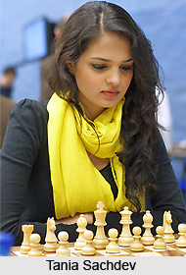
Project Introduction -S
Challenged with creating a decentralized application that leverages the blockchain.
Turning an Over-The-Board game experience into using a blockchain contract as a secure immutable mediator for correspondence play.
In the interest of world domination we decided to implement the game of RISK.

Slide 3
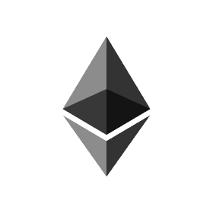
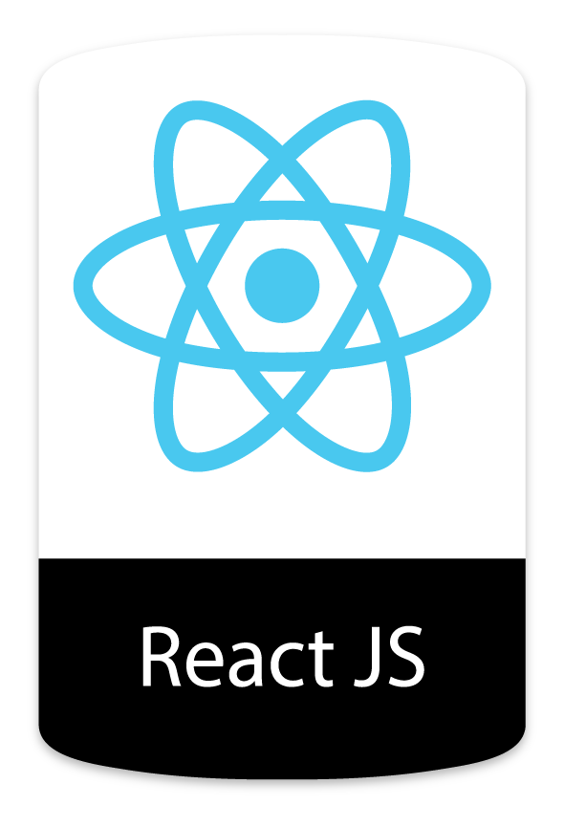

Our approach -D
Smart Contract on Ethereum, written in Solidity. Deployed on Rinkeby test network.
React javascript user interface leveraging an svg of the game-board into an interactable react component for an intuitive visually driven experience.
Leveraging Web3 tools to interact with the smart contract.

Slide 4

Issues encountered - L
Limitations of Solidity
Gas Limitations
Size of Contract
RISK requires lots of data to be stored for the game to function.
Blocks can only hold so much bytecode.
Storage contains data and functions
Operation Complexity
There is a hard cap on max gas per transaction.
Limited Features
No string/address array passing
No nested Structs
No built in array sorting
No built in to-strings or string concatenation
Required multiple major refactors…
In the final hours...

Slide 5
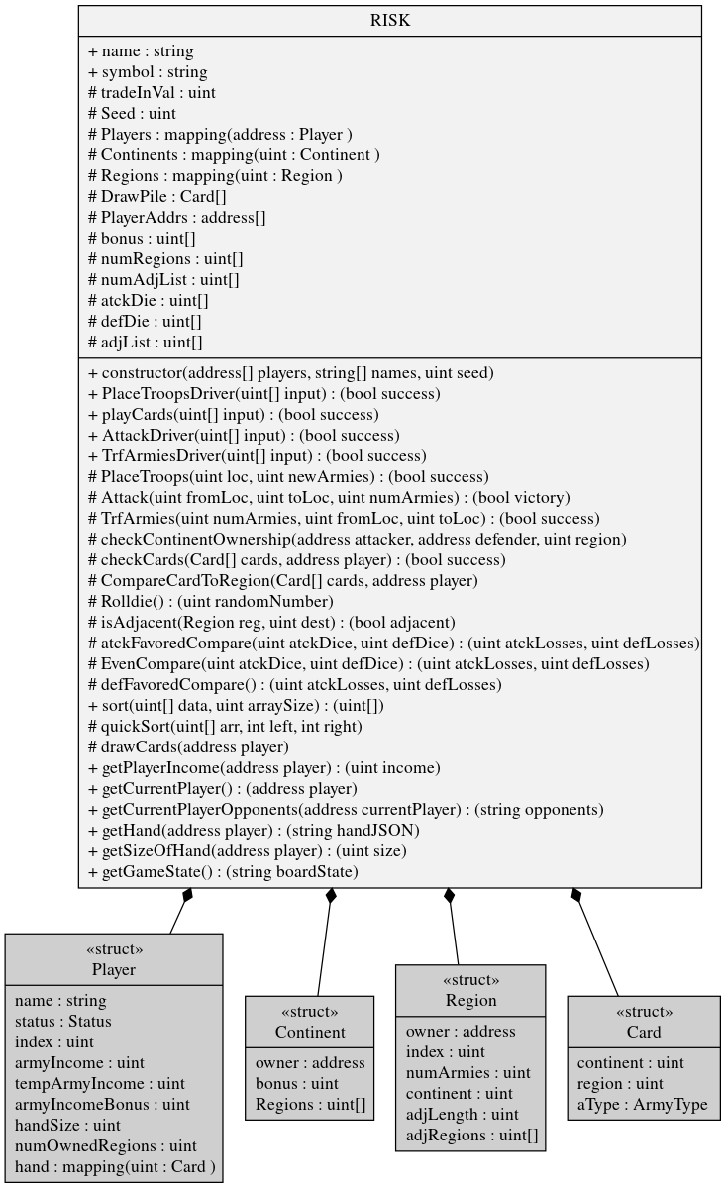
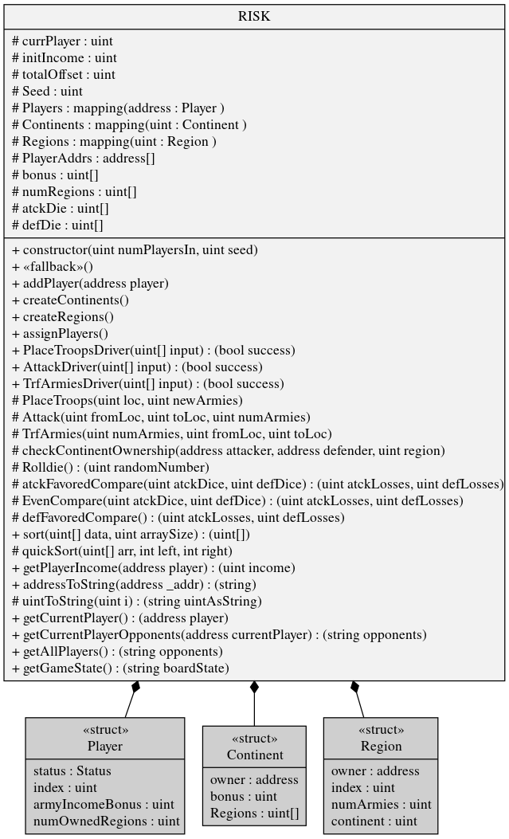


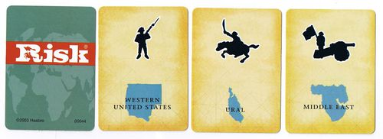
Resolution of issues
Complex Initialization
No RISK cards
Allows the possibility of a truck being driven through it.

Slide 6

Flow of Game -S
Game Initialization phase
Contract Construction
Add Players
Initialize continents and countries data structs
Initialize player ownership of countries
Each turn consists of:
Placement Phase - Additional income of troops based on countries owned and continent bonuses can be placed on countries that are owned.
Attack Phase - All attacks are decided up front in a turn and are queued up in the UI until transacted to the contract.
Reinforcement Phase - This is where owned troops can be reinforced into adjacent owned countries.

Slide 7
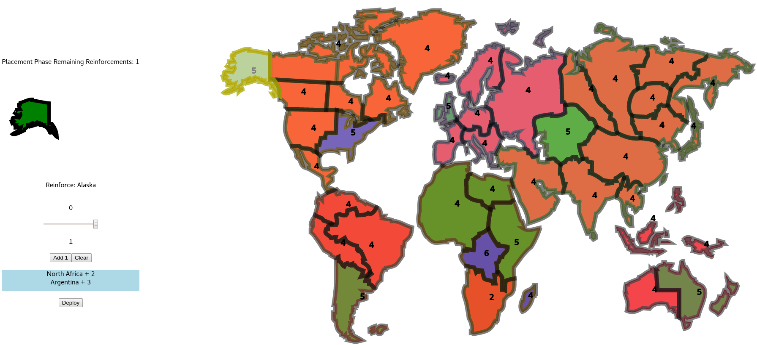
Placement Phase -D

Slide 8
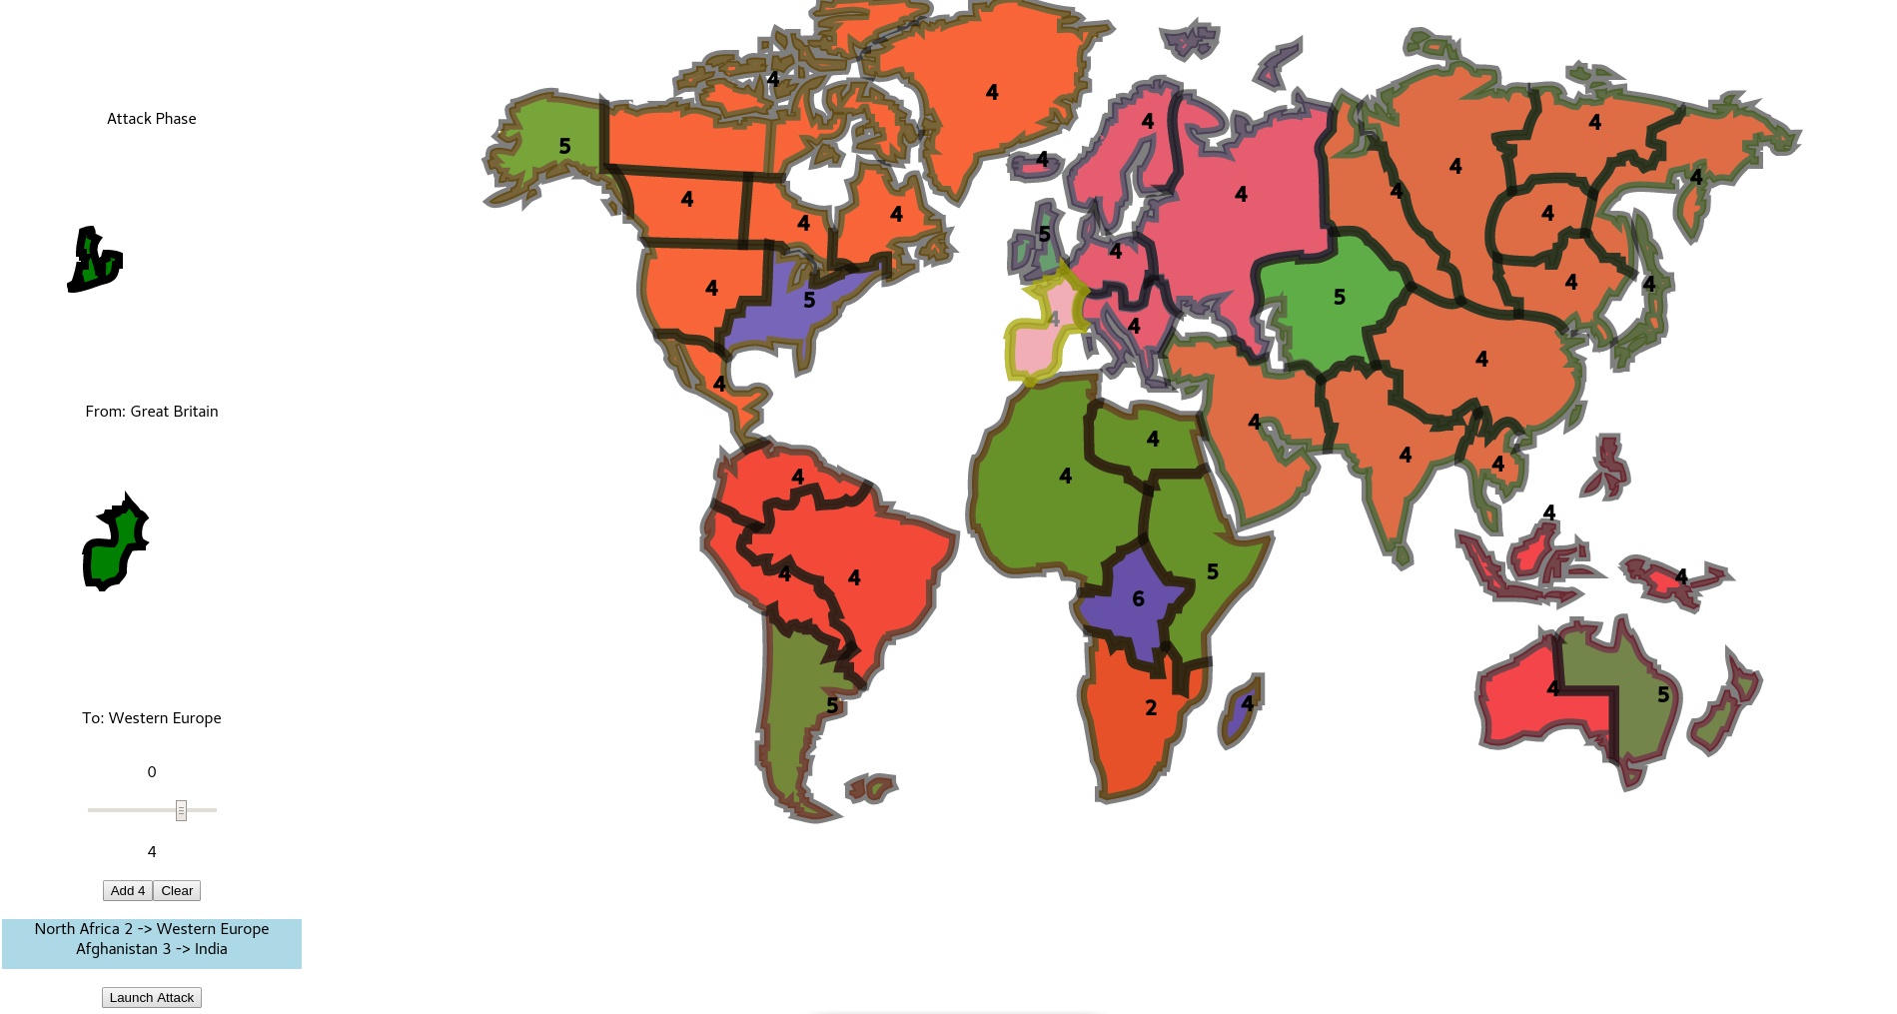
Attack Phase -L

Slide 9
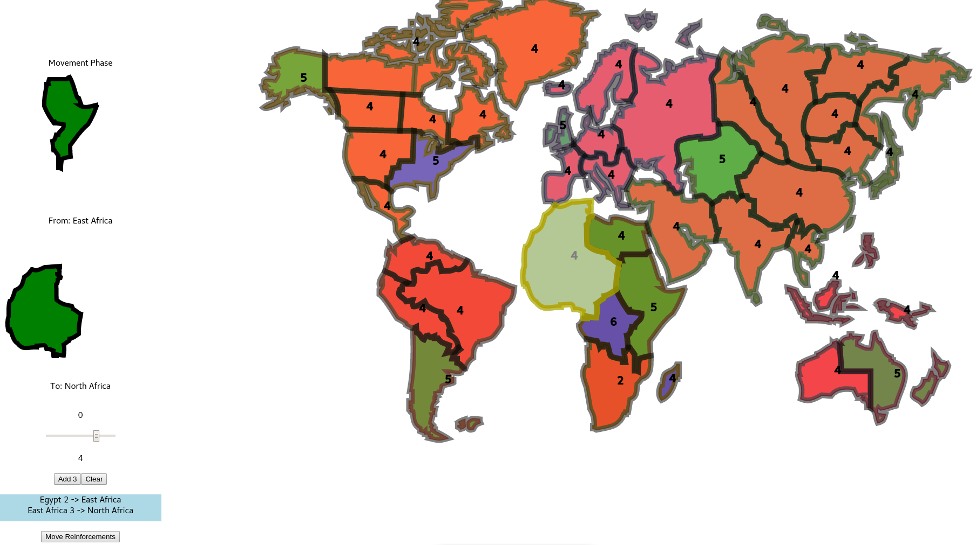
Reinforcement Phase -S

Slide 10

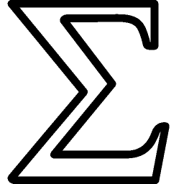
That’s a Wrap -S
Summing things up
Used Ethereum blockchain and Smart contracts to facilitate player interactions.
Created sleek and interactive dapp using React, web3, and Solidity.
Redesign classic gameplay into contractual interactions.
Looking to the future
Refactor to a fleet of contracts to implement full feature set, safety and functionality.
Create a master contract that can create deploy a fleet of contract for a new game session.
Host the UI portion for users to access without installing software.
Add instructions, and tooltips to help the player control the game.

Slide 11

Final Thoughts
Ethereum is a ever evolving infant that has proven that it can help the community develop tools to keep big brother from managing your affairs.

